Slide 1
Introduction to quantum computing for laymen
https://automatski.com
info@automatski.com

Slide 2
What is a Quantum Computer?
A quantum computer is a type of computing device that uses the principles of quantum mechanics to process information. Unlike classical computers, which use bits as the basic unit of information (representing either a 0 or a 1), quantum computers use quantum bits or qubits.
Qubits:
A qubit can exist in a state of 0, 1, or both simultaneously due to a property called superposition. This allows quantum computers to process a vast amount of possibilities at once, making them potentially much more powerful than classical computers for certain tasks.
Superposition:
Superposition allows a quantum system to be in multiple states at once. For example, a qubit can be both 0 and 1 simultaneously. This enables quantum computers to explore many possible solutions to a problem at the same time.
Entanglement:
Qubits can be entangled, meaning the state of one qubit is directly related to the state of another, no matter the distance between them. Entanglement enables quantum computers to perform complex computations more efficiently than classical computers.
Quantum Interference:
Quantum computers use quantum interference to amplify the correct answers and cancel out the incorrect ones. This property is leveraged in algorithms like Shor's algorithm (for factoring large numbers) and Grover's algorithm (for searching unsorted databases).
Quantum Gates:
Quantum computers perform operations using quantum gates, which manipulate qubits in a manner analogous to logical gates in classical computers. Quantum gates are reversible and can process qubits in parallel.

Slide 3
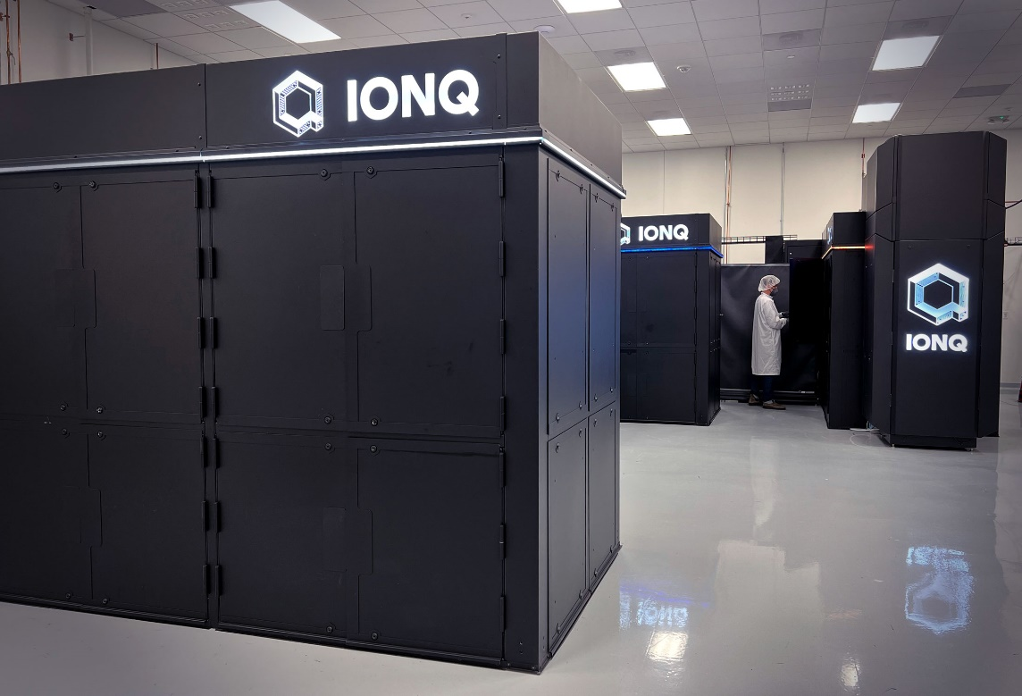
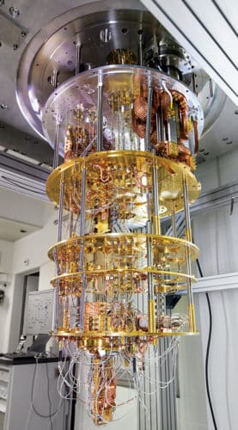
This is what it looks like
From outside
Inside the box

Slide 4
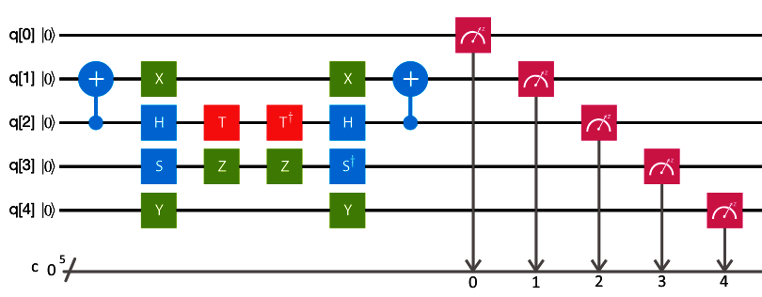
It runs quantum circuits like these

Slide 5
Qubits are shown on the left hand side and by convention they All start in state 0 (false)
This is a 5 Qubit Circuit
q[0],q[1],q[2],q[3],q[4]
All qubits are in state 0 (false) denoted by |0> state 1 (true) would be denoted by |1>

Slide 6
These are the Quantum Gates
This is a 1 Qubit gate called ‘Y’ Gate. 1 Qubit gates act on 1 qubit only.
Here this Y gate is acting on the 5th qubit q[4]
This is a 2 Qubit CNOT Gate acting on
Two Qubits q[1] and q[2]

Slide 7
In the end you measure the qubits
At the end of the quantum circuit you measure one or
More qubits to get the results. Each qubit will collapse to only either 0 or 1 state

Slide 8
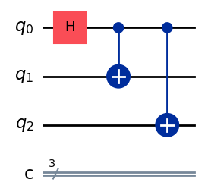
Lets understand all this a bit more
This is a 3 Qubit Circuit.
The Gate H acts on the first qubit q0. And makes it half true and half false. Both true and false the same time with equal probabilities.
These blue gates are the CNOT gates or the Controlled Not Gates. They act on two qubits at one time. If the first (control) qubit is true it flips (Not’s) the second qubit.
Here one CNOT gate is acting on qubits 0 (control) and 1 (target)
And another CNOT gate is acting on qubits 0 (control) and 2 (target)
Since qubit 1 is in both 0 (false) and 1 (true) state equally. The CNOT gates make the qubits 1 and 2 both half true and half false.

Slide 9
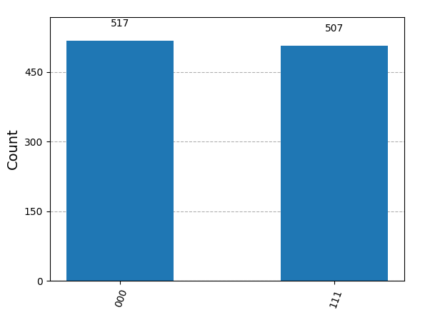
This is what the results look like
This result is called the histogram of probabilities of the result quantum states
When you measure 3 qubits you will get multiple answers of combinations of states of the 3 qubits e.g. 000, 001, 010, 011, 100, 101, 110, 111 etc.
But because of your computations in the quantum circuit they will occur with different probabilities.
Quantum Computing is about finding the result state with the highest probability.
Here out of 1024 (number of shots) times the quantum computer measure the results. 517 times it got the state 000 and 507 times it got the state 111. here 517 and 507 are called counts of the occurrence of states.

Slide 10
Let us try to build a quantum circuit in python and execute it

Slide 11
What is a ghz state
The GHZ (Greenberger-Horne-Zeilinger) state is a specific type of entangled quantum state involving three or more qubits. Named after the physicists who first described it, the GHZ state is often represented for three qubits as 1/sqrt(2)*​(∣000⟩+∣111⟩). It is a maximally entangled state, meaning that the qubits are correlated in such a way that the state of any individual qubit is completely dependent on the states of the others.
The GHZ state exhibits fascinating quantum properties, such as non-local correlations and violation of certain classical inequalities (e.g., Mermin's inequality). It serves as a quintessential example of quantum entanglement, where measurements on one qubit instantaneously affect the outcomes of measurements on the other qubits, regardless of the distance between them.
In quantum computing, the GHZ state is used in various algorithms, protocols, and experiments to demonstrate and utilize quantum entanglement. It plays a role in quantum error correction, quantum cryptography, quantum teleportation, and more. The ability to prepare and manipulate GHZ states is essential for many quantum information processing tasks.
Creating a GHZ state requires precise control over qubits and their interactions. It can be achieved through a series of quantum gates, such as Hadamard and Controlled-NOT (CNOT) gates. Manipulating and maintaining the GHZ state also requires careful handling, as it is sensitive to noise and decoherence.

Slide 12
The circuit & The expected result

Slide 13
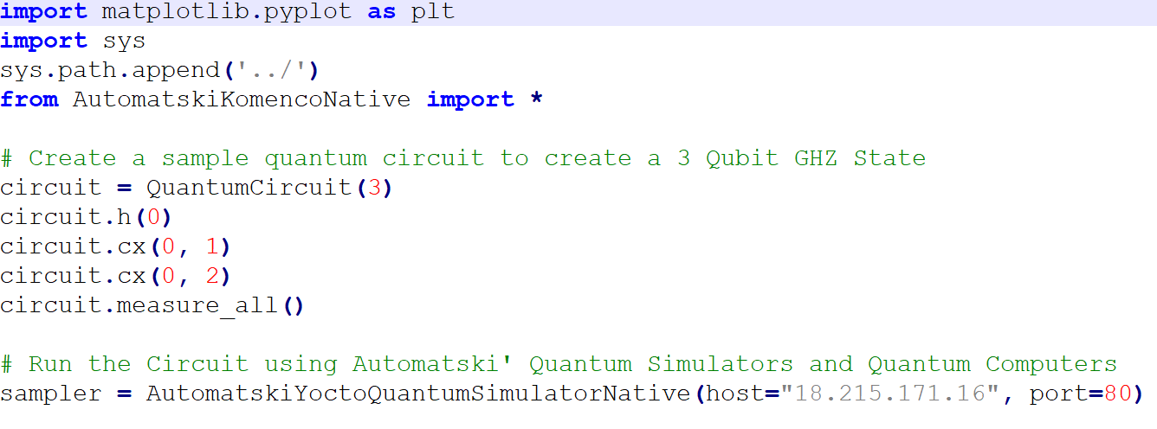
Quantum circuit to prepare a GHZ State1
Import the Native Komenco library
Define the Quantum Circuit
Initialize the Komenco Simulator

Slide 14
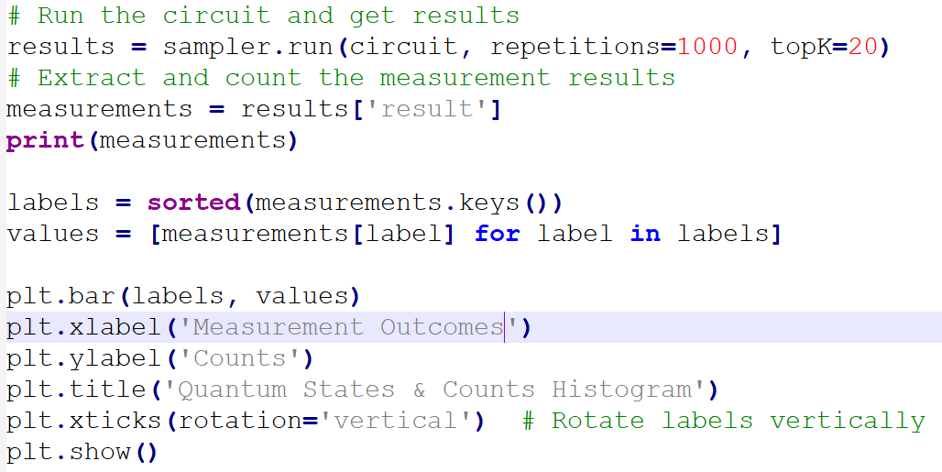
Quantum circuit to prepare a GHZ State1
Run the quantum circuit 1000 times and get the top 20 highest probability results our of 2^{N} possible quantum states
Plot the Histogram

Slide 15
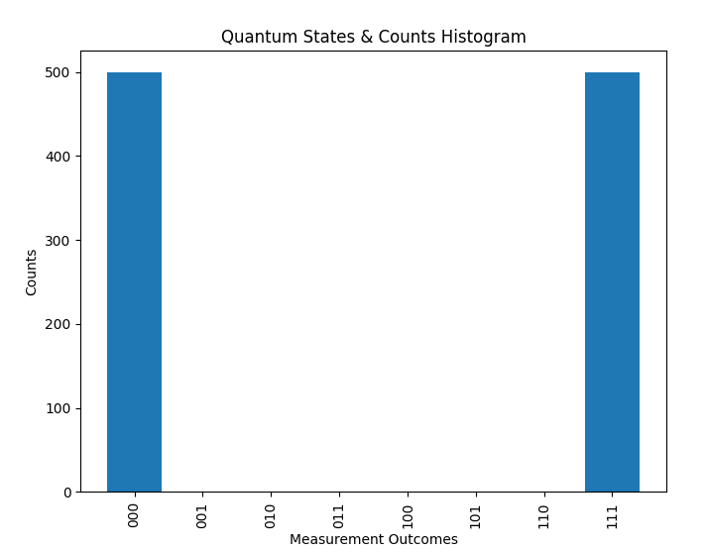
Perfect Results from the yocto simulator

Slide 16
Further…

Slide 17
From here…
There are 100’s of examples of Quantum Computer Programming on the internet, courses on Udemy and Coursera, videos on Youtube to learn from.
But you can start with the Quantum Computing and Quantum AI examples in our Yocto SDK to begin with.

Slide 18
conclusion
Programming Quantum Computers requires Maths, Physics, Chemistry and Programming. It requires training. It is not something that can be done casually!!!
And it requires lots and lots of practice.
So the best way to learn all this and get started with quantum computing is to buy a subscription to our Komenco Quantum Simulator and get cracking problems today.
*** FREE TRIAL AVAILABLE
If you need a production grade Quantum Simulators or Quantum Computers we have those too but they cost millions of dollars.

Slide 19


Slide 20
Sources & References

